Slide 1
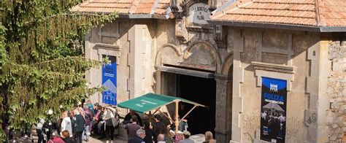
Pilot Solution Title
Subtitle

Slide 2
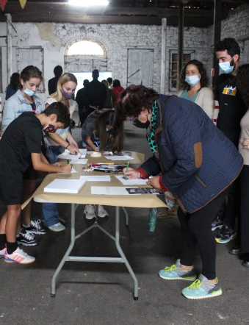
Project Overview
Short Description(100–150 words)
Detailed Description

Slide 3
Problem Statement
Write here
Bold Vision
A strong vision explains what it is and why it matters.
Turbulences
What turbulences did you map and confront

Slide 4
Where You are Now
How did we get here?
How did pilots respond to territorial challenges?
How did you build on local identity and history
Estimated Duration
Pilot status

Slide 5
What if…

Slide 6
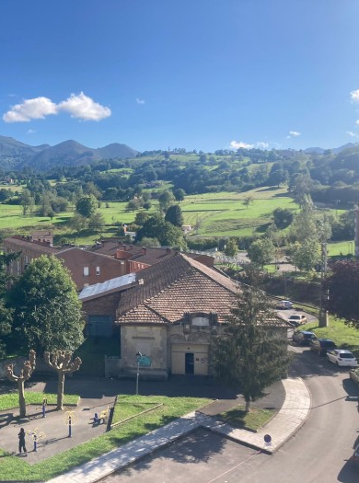
What if…
What if as a:
I could:
With:
So that:

Slide 7
Who will benefit?
More detailed overview of Target Groups
Show engagement through: letters of support, participation records, community meetings, partnerships
subtitle

Slide 8
Key Learnings
description of key learnings
subtitle

Slide 9
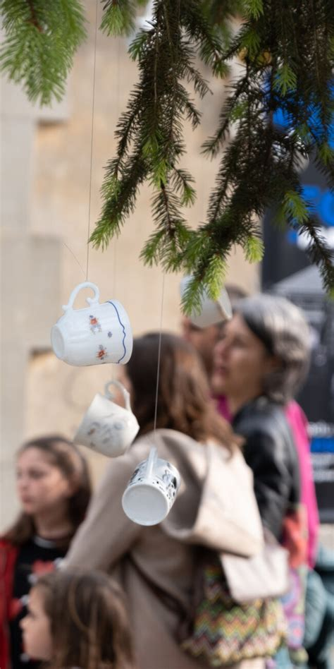
NEB Values
Beauty – Ambition: [insert]
How did you accomplish this ambition? Design concepts, cultural programming, artistic vision
Sustainable – Ambition: [insert]
How did you accomplish this ambition? Sustainability measures, SDG mapping
Together – Ambition: [insert]
How did you do this? an inclusion strategy, community programming, etc.

Slide 10
NEB Working Principles
Participatory Process Ambition: [insert]
How did you accomplish this ambition?
Multi-Level Engagement Ambition: [insert]
How did you accomplish this ambition?
Transdisciplinary Approach Ambition: [insert]
How did you accomplish this ambition?

Slide 11

Common Themes
What are some themes you feel your pilot shares with the larger mediterranean region?

Slide 12
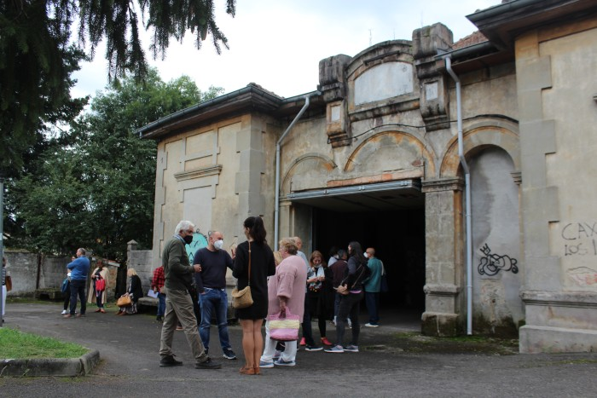
Lessons Learned
What surprised you? How did you resolve or overcome obstacles? What will you do differently?

Slide 13
Sharing for the Future
What knowledge can contribute to the toolbox
B4M Toolbox

