Slide 1
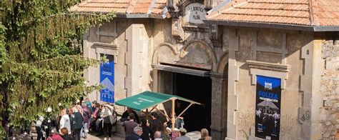
Example Portfolio: La Benéfica de Piloña
Cultural Space

Slide 2
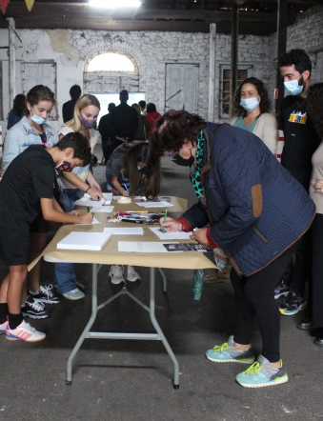
Project Overview
La Benéfica, Espaciu Cultural is an initiative to rehabilitate and reactivate a historic 1926 building in L’Infiestu, Piloña (Asturias), originally built as the headquarters of the local Mutual Aid Society. The 400 m² hall once served as a theatre, dance hall, cinema, and a social hub. After decades of disuse—having been a sweet factory, then a car park, then abandoned—the project aims to restore the building and revive its original community spirit through culture.
The new La Benéfica will be a hybrid space combining contemporary and avant-garde artistic expression, popular and traditional culture, intergenerational knowledge transmission, and community engagement. It aspires to become a cultural driver for rural Asturias, offering a reason for people—especially young people—to stay, create, and enjoy culture locally, while building national and European cultural networks.

Slide 3
Problem Statement
Rural areas in Asturias face depopulation, abandonment, and limited cultural infrastructure. There is no comparable space in eastern Asturias that integrates contemporary art, traditional culture, community action, and youth engagement.
Bold Vision
To transform a once-abandoned mutual aid hall into a model for rural cultural regeneration, where community, heritage, contemporary arts, and intergenerational knowledge exchange shape a new, vibrant life for the territory.
La Benéfica seeks to become a reference point in Spain for how culture can fight depopulation, isolation, and rural decline.
Turbulences
Cost and technical difficulty
Administrative hurdles
Sustaining cultural activity in a small rural municipality.
Limited initial resources or intermittent funding.

Slide 4
What if…

Slide 5
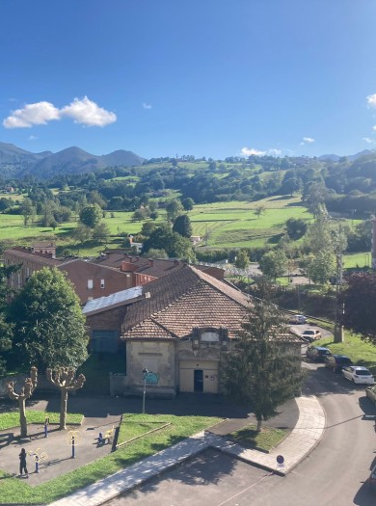
What if…
What if as a: local resident / artist / visitor / young person
I could: access cultural events, workshops, performances, shared creation spaces, and community programming
With: a restored, accessible, and community-governed cultural venue
So that: I can participate in culture locally, feel part of a community, learn across generations, and contribute to the revitalisation of rural life

Slide 6
Who will benefit?
Local residents of Piloña and surrounding rural areas:As a space to participate in workshops, performances, community events, and intergenerational learning
Artists and cultural creators (local, national, and international): As a platform to exhibit, perform, collaborate, and experiment in a rural environment with strong community roots.
Young people:As a place to gather, create, attend events, and engage in artistic and cultural formation—an alternative to leaving rural areas.
Visitors and cultural tourists: As a unique venue showcasing contemporary creativity and Asturian cultural identity.
Local businesses: Through increased visitation, partnerships, and economic activation linked to cultural programming.
Creating more participatory processes with stakeholder engagement

Slide 7
Key Learnings
The community strongly perceives this project as a shared need, not just an external initiative. Local enthusiasm confirmed that cultural spaces can drive rural revitalisation even in small municipalities.
The process revealed broad willingness from neighbours to local businesses to collaborate, volunteer, and support the recovery of the building.
Partnerships with public and private entities demonstrated that rural projects can attract national attention and alliances.
Creating more participatory processes with stakeholder engagement

Slide 8
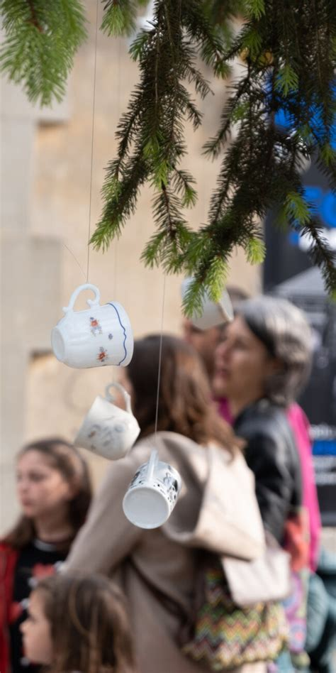
NEB Values
Beauty – Ambition: to activate
Respects the historical architecture while creating an inspiring artistic space.
Reintroduces aesthetic and sensory experiences through art, performance, and community events.
Sustainable – Ambition: to regenerate
Rehabilitation of an existing building reduces environmental impact.
Supports rural dynamism, reducing the need for cultural displacement to cities.
Together – Ambition: to transform
Built from the ground up through community support and collective participation.
Strengthens social bonds and intergenerational knowledge exchange.

Slide 9
NEB Working Principles
Participatory Process Ambition: to co-develop
The project was co-designed with strong neighbour involvement.
Ongoing collaboration with local associations, volunteers, and supporters.
Multi-Level Engagement Ambition: to work across levels
Local: engagement with neighbours, schools, associations, municipality.
Regional/National: partnerships with Asturias-based companies and Spanish cultural institutions.
Transdisciplinary Approach Ambition: to be beyond-disciplinary
Combines architecture, heritage, contemporary arts, folklore, social work, and community organisation.
Involves professionals from cultural management, design, music, theatre, and education.

Slide 10
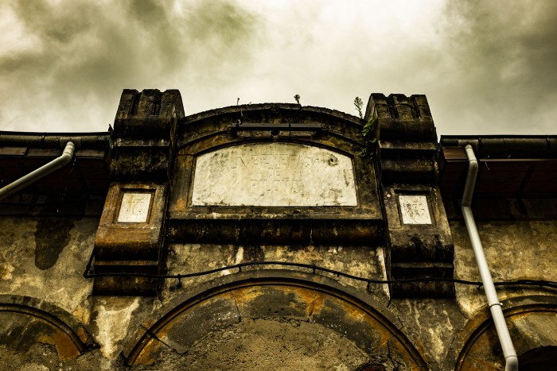
Common Themes
Rural depopulation and demographic ageing
Abandonment of heritage buildings and traditional infrastructures
Territorial imbalance between coastal/urban hubs and interior rural areas
Fragmented governance and limited funding for small municipalities
Limited mobility and access to cultural offerings

Slide 11
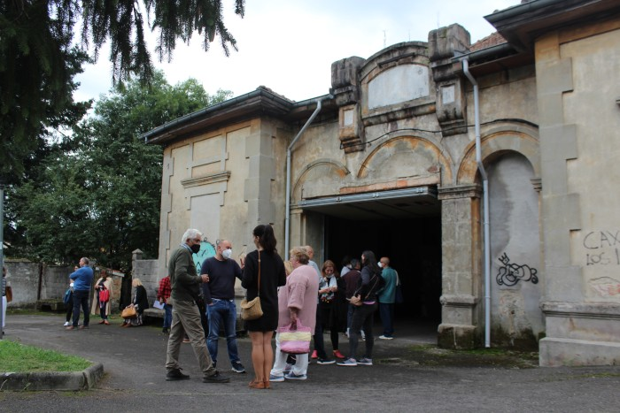
Lessons Learned
Rural heritage buildings as anchors for Mediterranean revitalisation
Intergenerational knowledge as a Mediterranean resource
Hybrid cultural models suited to Mediterranean rural economies
Sensory identity as a Mediterranean cultural asset

Slide 12
Sharing for the Future
Key steps to showing how heritage buildings can be recovered as catalysts of rural transformation and how culture is a powerful tool to combat depopulation and strengthen community identity.
Stories of when community participation was most effective when aligned with shared historical memory and when residents feel genuine ownership.
B4M Toolbox

